Slide 1
OpenCameraRefined
Grp 211:
Pedram Yazdinia
Faisal Jaffer
Zayed Sheet
Dominik Buszowiecki

Slide 2
Introduction
Many people using their camera application on their Android mobile devices encounter issues where a certain functionality may be inaccessible. This could be because the functionality is difficult to find, use or simply does not exist. Often, we can see that users tend to prefer external applications such as Snapchat, Instagram and TikTok for a camera because of the features and functionalities that make it more accessible towards the user's needs.
OpenCameraRefined is designed to change the way we capture pictures through our phones. Using image processing algorithms and machine learning, the team is focused on enabling the software to process and recognize a certain gesture in real time while being able to offer real time filter.

Slide 3
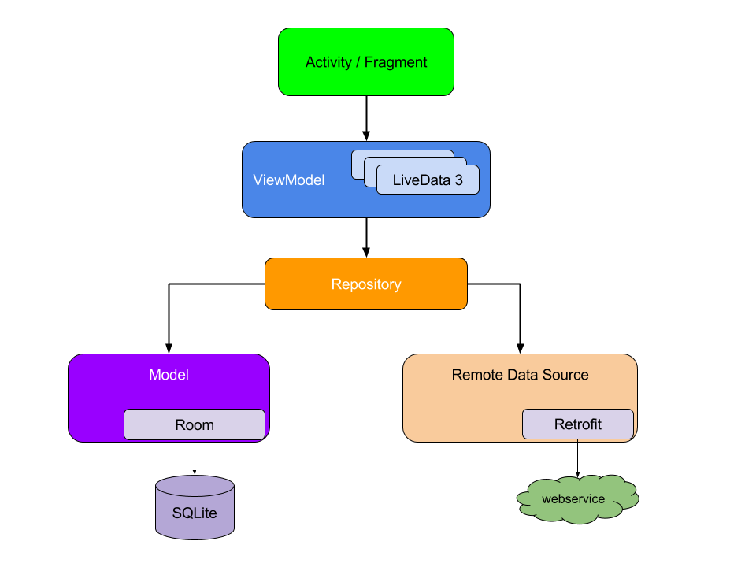
Android Architecture
Notes:
Android system initiates its program within an Activity starting with a call on onCreate() callback method. There is a sequence of callback methods that start up an activity and a sequence of callback methods that tear down an activity. This model is loosely based on MVC architecture with the controller
being the Activity class, View being the resources and widgets and model being the entities or Classes with main Business Logic. This design creates a consistent and pleasant user experience. Regardless of whether the user comes back to the app several minutes after they've last closed it or several days later, they instantly see a user's information that the app persists locally.

Slide 4
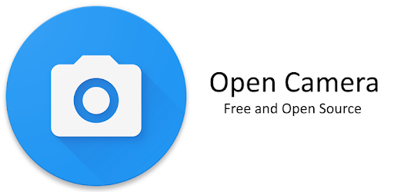
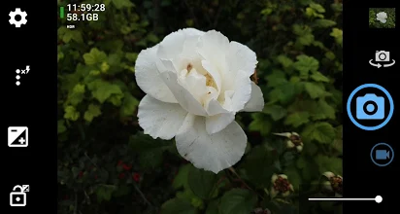
The Project

Slide 5

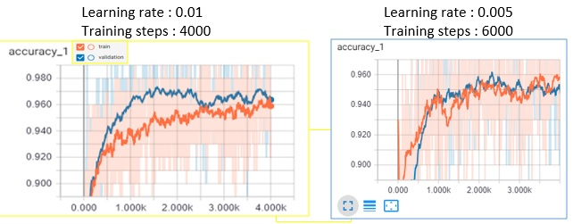
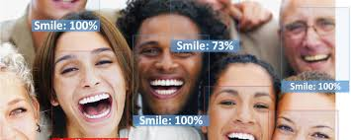
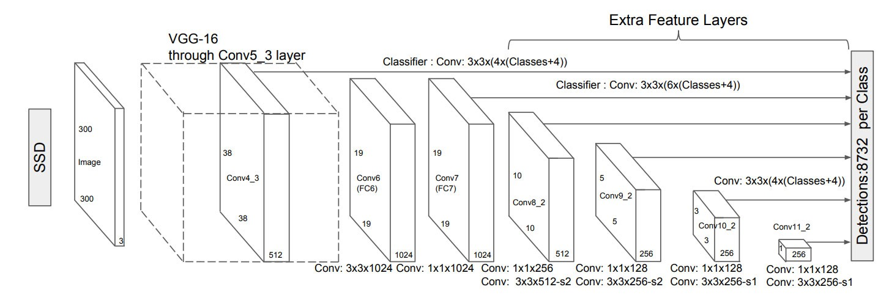
Detection Training
Label Data
2. Training
3. Validation
Image
Image File
XML File
smile: {coordinates}
thumb: {coordinates}
Data set consists of 100 images

Slide 6
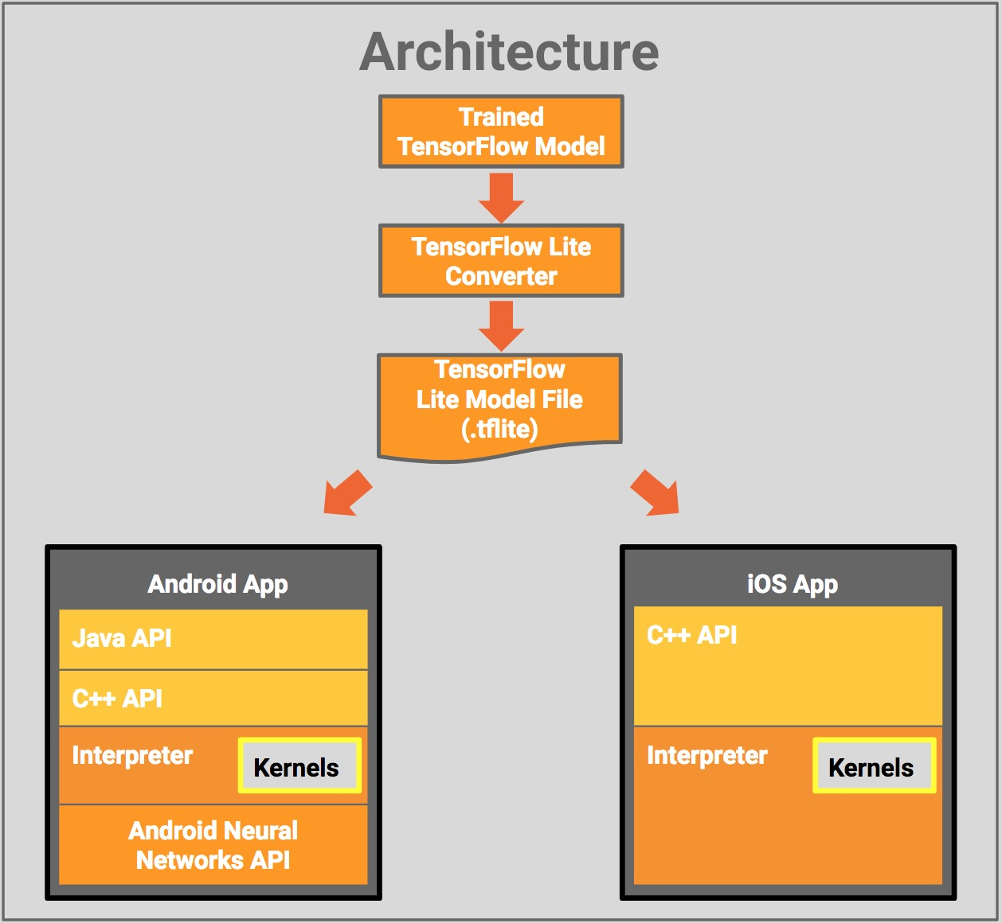
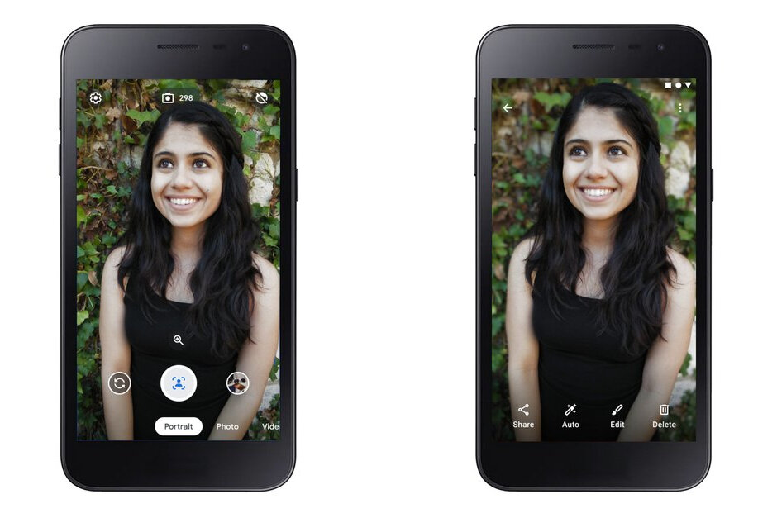
Detection Deployment
Faces? WHERE??
Thumb? WHERE??
GestureController

Slide 7

Detection Demo

Slide 8

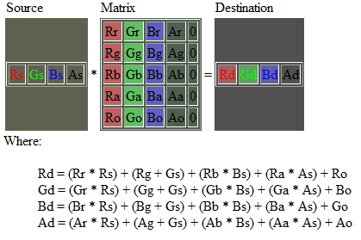


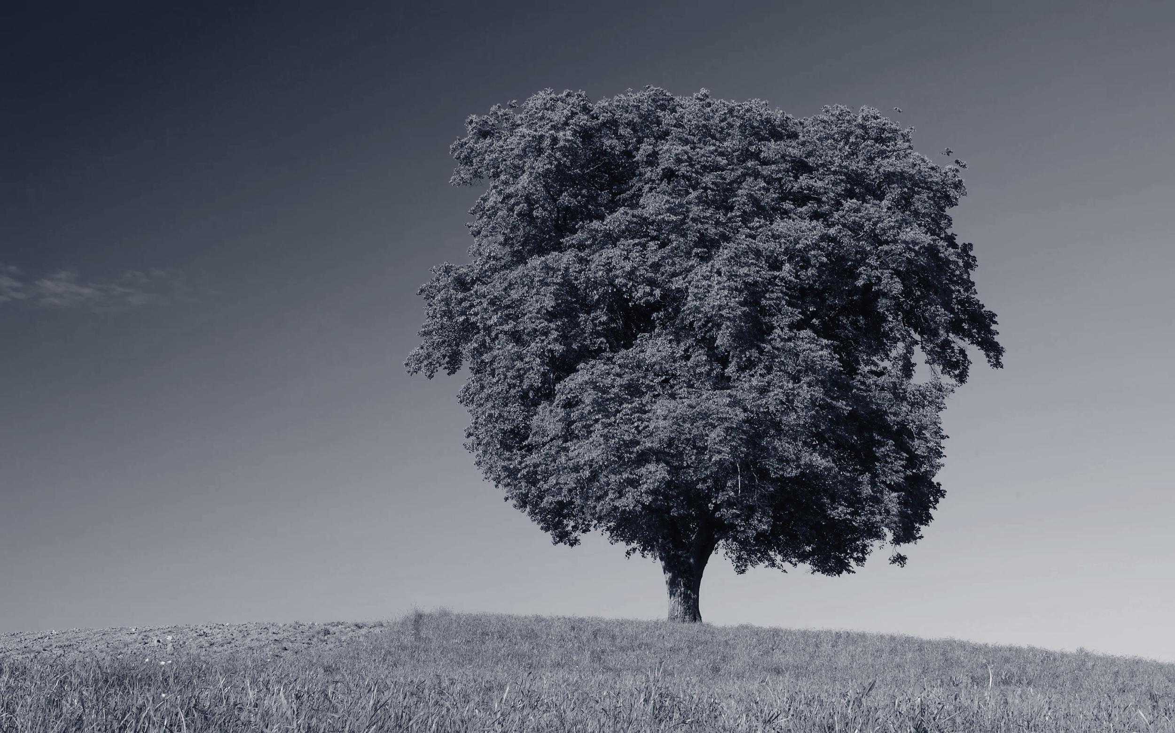
Image Filtering

Slide 9
Image Filter Demo

Slide 10
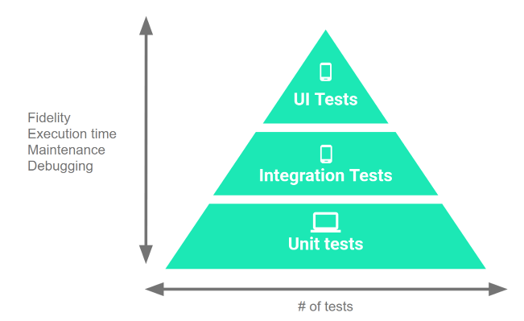
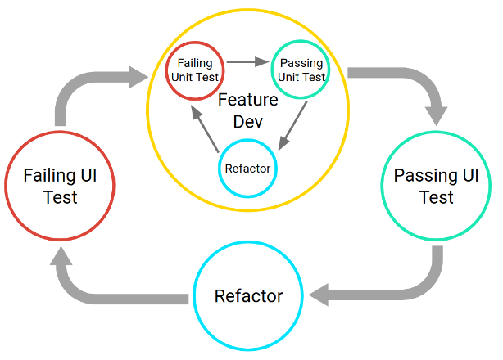
Discussion and Testing

Slide 11
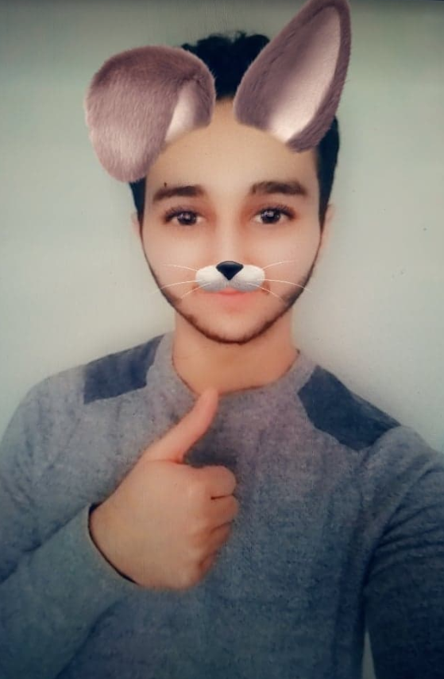
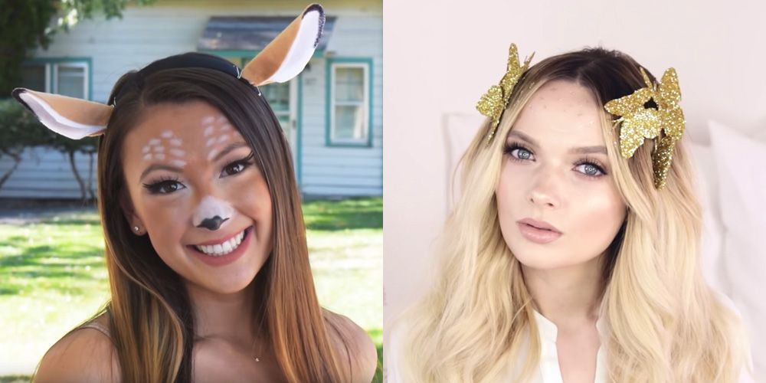
Next Steps and Conclusion

Slide 12
Questions

